Slide 1
Recognizing Subjects

Slide 2
Recognising subject
The second step in learning the basics of English grammar is to be able to recognize the subject.
After you have found the verb, you should then find the subject.

Slide 3



Recognising subject
You can find the subject by asking Who or
What? in front of the verb.
John swept the sidewalk.
Who or what swept ?
John
Sarah considered the problem for three hours.
Who or What considered?
Sarah
The computer saved the company a fortune.
Who or what saved the company a fortune?
computer

Slide 4
Recognising subject
Obviously, the subject is a naming word. The subject of an action verb names the doer of the action.
In the sample sentences just presented, John does the action of sweeping, Sarah does the action of considering, and the computer does the action of saving.

Slide 5

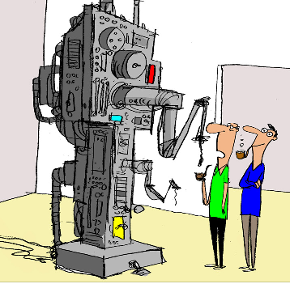
Recognising subject
Like any other subject, the subject of a linking verb is a naming word.
Also like any other subject, the subject of a linking verb can be found by asking Who or What? In front of the verb.
Gene Caudill is president of the Exeter Company.
Who or What is? Gene Caudill
The machine is a constant source of trouble.
Who or What is? machine

Slide 6

Recognising subject
The sample sentences above follow the most common order an English sentence takes: subject- verb. However, not all sentences in English follow the subject –verb order.
Sentences beginning with the word there usually alter the subject-verb order.
Subject
There are four girls on the Little League team.

Slide 7
Recognising subject
Don't mistake the expletive there for the subject.
It merely indicates that the subject will follow the verb.
(An expletive like there only serves as a filler and does not contribute to the meaning of the sentence.)

Slide 8
Recognising subject
If you get in the habit of finding the verb and then asking Who or What? In front of it, you should have no trouble with sentences that are not in the subject- verb order.
In the following example sentence, if you know that are is the verb and ask Who or What are?
You will easily see that the subject is girls.
There are four girls on the Little League team.

Slide 9
Exercise
Is Robert making a new piece for the machine?
Is the sentence in the subject-verb order?
No
Is it in the auxiliary-subject-verb order?
Yes
If you ask Who or What is making? You will see that
the answer is, the subject,
Robert

Slide 10
Exercise
The easiest way to find the subject and verb in such a sentence is to turn the question:
Is Robert making a new piece for the machine?
into a statement:
Robert is making a new piece for the machine.
Now the sentence is in the subject-verb order.

